Slide 1
Churn Modelling

Slide 2
Introduction
Objective
The objective of this model is to predict customer churn (whether a customer will leave the bank or not) based on their demographic, financial, and account activity data. This helps the bank take proactive measures to improve customer retention and minimize churn.
To analyze customer churn data and identify key patterns and trends.
Understand factors contributing to customer churn and suggest actionable insights

Slide 3
Dataset Overview
Source : Churn Model
Size : 10,000 rows, 14 columns
Target Variable: `Exited` (Churn status)
Key Features :
- Demographics : ‘Geography’, ‘Gender’, ‘Age’
- Financial : ‘Balance’, ‘EstimatedSalary’, ‘NumOfProducts’
- Account Activity : ‘Tenure’, ‘IsActiveMember’

Slide 4
Data Cleaning Steps
1. Removed Missing Values :
- Checked for nulls and dropped rows with missing data.
2. Dropped Unnecessary Columns
- ‘RowNumber’, ‘CustomerId’, and ‘Surname’ removed.
3. Encoded Categorical Variables
- One-hot encoding for ‘Geography’.
- Label encoding for ‘Gender’.
4. Scaled Numerical Features
- Applied Min-Max scaling to ‘Balance’and ‘EstimatedSalary’.

Slide 5
Key Statistics
Demographics
Gender :
- Male : 54%
- Female: 46%
Geography :
- France : 50%
- Spain : 25%
- Germany : 25%
Age Distribution :
- Median Age : 39 years
Financial
Balance :
- Average Balance : $76,000
Products
- 1 Product : 51%
- 2 Products : 41%

Slide 6
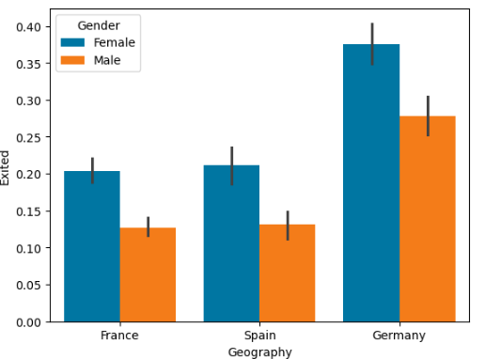
Visualizations
Churn Analysis
The graph shows that customer churn rates are highest in Germany and lowest in France. Across all countries, females have a higher churn rate than males, with the largest gender gap in Germany.

Slide 7
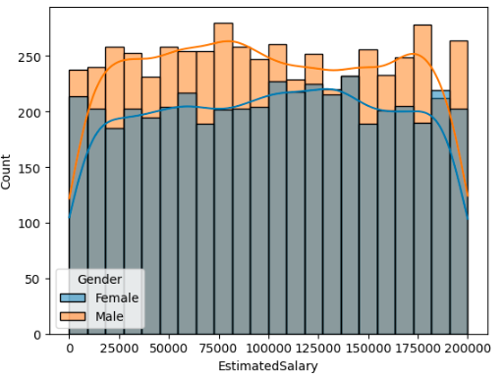
Visualizations
Financial Behavior
The graph shows that male customers consistently outnumber female customers across all salary ranges. The distribution of salaries is fairly uniform for both genders, with the highest counts in the middle salary ranges (75,000 to 150,000).

Slide 8
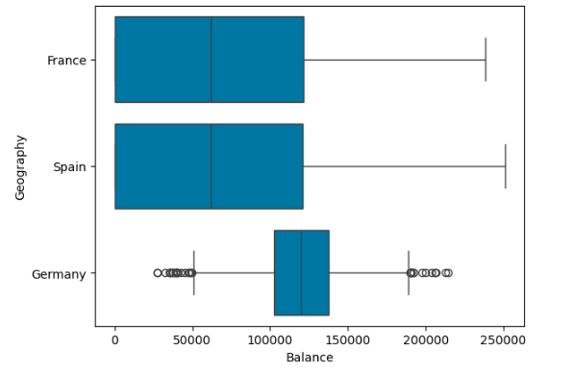
Visualizations
Financial Behavior
France and Spain have similar median balances around 100,000 with wide variability. Germany has a higher median balance (~125,000) with less variability but more low-balance outliers.

Slide 9
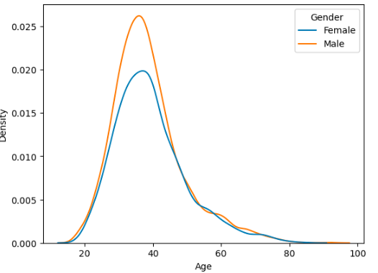
Visualizations
Customer Demographics
This Kdeplot between Age and Density while in gender coloumn,Male get more value upto 0.025 and Female gets inbetween 0.015 and 0.020 across the age.

Slide 10
Recommendations
Retention Strategies
1.Targeted Campaigns :
- Focus on customers in Germany and younger age groups.
2. Enhance Customer Engagement :
- Provide incentives for low-balance customers.
- Encourage inactive members to increase activity.
3. Product Bundling:
- Promote additional product usage to reduce churn.

Slide 11
Conclusion
Summary
- High churn observed in germany and among customers with low financial activity.
- Financial engagement and age are strong predictors of churn.
Next Steps
- Implement retention strategies and measure performance.
- Monitor churn trends quarterly to adapt strategies.

Slide 12
Thank you for your attention!

